Slide 1
Multimedia System and Virtual Environment
CSE – 310
Lecture 5
Color
Dept. of Computer Science and Engineering, University of Rajshahi

Slide 2
Image/Graphics
Lecture 5
Computer Color Models
Models or methodologies used to specify colors in computer terms are RGB, HSB, HSL, CMYK, CIE, and others.
In the HSB (hue, saturation, brightness) and HSL (hue, saturation, lightness) models, you specify hue or color as an angle from 0 to 360 degrees on a color wheel, and saturation, brightness, and lightness as percentages.
Saturation is the intensity of a color. At 100% saturation, a color is pure; 0% saturation, the color is white, black or gray.
Lightness or brightness is the percentage of black or white that is mixed with a color. A lightness of 100% will yield a white color; 0% is black; the pure color has a 50% lightness.
Dept. of Computer Science and Engineering, University of Rajshahi

Slide 3
Image/Graphics
Lecture 5
RGB Color Model
The RGB color model is an additive color model in which red, green, and blue light are added together in various ways to reproduce a broad array of colors.
The name of the model comes from the initials of the three additive primary colors, red, green, and blue.
The main purpose of the RGB color model is for the sensing, representation, and display of images in electronic systems, such as televisions and computers.
RGB is a device-dependent color model: different devices detect or reproduce a given RGB value differently, since the color elements (such as phosphors or dyes) and their response to the individual R, G, and B levels vary from manufacturer to manufacturer, or even in the same device over time.
Dept. of Computer Science and Engineering, University of Rajshahi

Slide 4
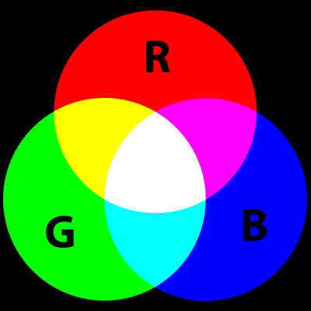
Image/Graphics
Lecture 5
RGB Color Model cont.
Additive primary colors
To form a color with RGB, three colored light beams (one red, one green, and one blue) must be superimposed.
Zero intensity for each component gives the darkest color (no light, considered the black), and full intensity of each gives a white.
Dept. of Computer Science and Engineering, University of Rajshahi

Slide 5
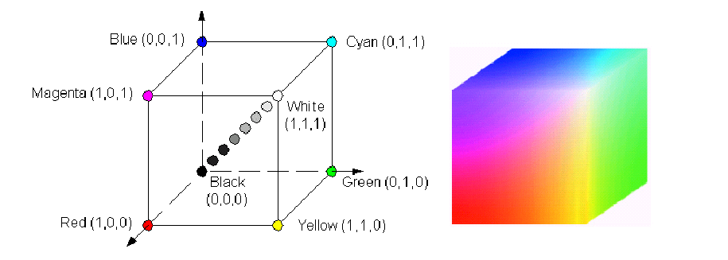
Image/Graphics
Lecture 5
RGB Color Model cont.
Geometric representation
(0, 0, 0) is black, (255, 255, 255) is white
(255, 0, 0) is red, (0, 255, 0) is green
(0, 0, 255) is blue, (255, 255, 0) is yellow
(0, 255, 255) is cyan, (255, 0, 255) is magenta
Dept. of Computer Science and Engineering, University of Rajshahi

Slide 6
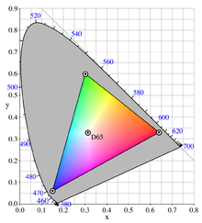
Image/Graphics
Lecture 5
RGB Color Model cont.
Physical principles for the choice of RGB
The normal three kinds of light-sensitive photoreceptor cells in the human eye (cone cells) respond most to yellow (long wavelength or L), green (medium or M), and violet (short or S) light.
The difference in the signals received from the three kinds allows the brain to differentiate a wide gamut of different colors, while being most sensitive (overall) to yellowish-green light and to differences between hues in the green-to-orange region.
Dept. of Computer Science and Engineering, University of Rajshahi

Slide 7
Image/Graphics
Lecture 5
RGB Color Model cont.
Truecolor
Truecolor is a method of representing and storing graphical image information that allows a very large number of colors, shades, and hues to be displayed in an image, such as in high quality photographic images or complex graphics.
Truecolor defines 256 shades of red, green, and blue for each pixel of the digital picture, which ultimately results in 2²⁴ or 16,777,216 (approximately 16.7 million) color variations for each pixel.
Dept. of Computer Science and Engineering, University of Rajshahi

Slide 8

Image/Graphics
Lecture 5
RGB Color Model cont.
The 24-bit RGB representation
In the 24-bit RGB representation of the truecolor, color values for each pixel encoded in a 24 bits per pixel fashion in which three 8-bit integer (0 through 255) represent the intensities of red, green, and blue.
A typical sample layout of a 24 bit Truecolor pixel
The letters R.G.B.A.X signify Red, Green, Blue, Alpha and Unused sample bit lengths, respectively.
Dept. of Computer Science and Engineering, University of Rajshahi

Slide 9
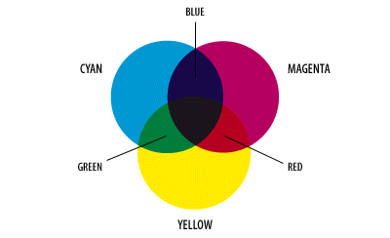
Image/Graphics
Lecture 5
CMY Color Model
A color model that specifies colors by the three parameters cyan (C), magenta (M), and yellow (Y), which define the amount of light subtracted in each case.
The primary colors of RGB are the secondary colors of CMY. But as the illustrations show, the colors created by the subtractive model of CMY don't look exactly like the colors created in the additive model of RGB. Particularly, CMY cannot reproduce the brightness of RGB colors.
Dept. of Computer Science and Engineering, University of Rajshahi

Slide 10

Image/Graphics
Lecture 5
CMY Color Model cont.
• Used internally in color printers
• Subtractive
• Complementary to RGB:
•C=1-R
•M=1-G
•Y=1-B
• Also CMYK (blacK)
– mostly for printer use
Dept. of Computer Science and Engineering, University of Rajshahi

Slide 11
Image/Graphics
Lecture 5
CMY Color Model cont.
The CMYK color model is a subtractive color model, used in color printing, and is also used to describe the printing process itself.
CMYK refers to the four inks used in some color printing: cyan, magenta, yellow, and key black.
The “K” in CMYK stands for key since in four-color printing cyan, magenta, and yellow printing plates are carefully keyed or aligned with the key of the black key plate.
The CMYK model works by partially or entirely masking colors on a lighter, usually white, background. The ink reduces the light that would otherwise be reflected. Such a model is called subtractive because inks “subtract” brightness from white.
Dept. of Computer Science and Engineering, University of Rajshahi

Slide 12
Image/Graphics
Lecture 5
Benefits of using black ink
Text is typically printed in black and includes fine detail (such as serifs), so to reproduce text or other finely detailed outlines using three inks without slight blurring would require impractically accurate registration.
A combination of 100% cyan, magenta, and yellow inks soaks the paper with ink, making it slower to dry, and sometimes impractically so. This also can cause the ink to bleed.
A combination of 100% cyan, magenta, and yellow inks often results in a muddy dark brown color that does not quite appear black. Adding black ink absorbs more light, and yields much darker blacks.
Using black ink is less expensive than using the corresponding amounts of colored inks.
Dept. of Computer Science and Engineering, University of Rajshahi

